Slide 1
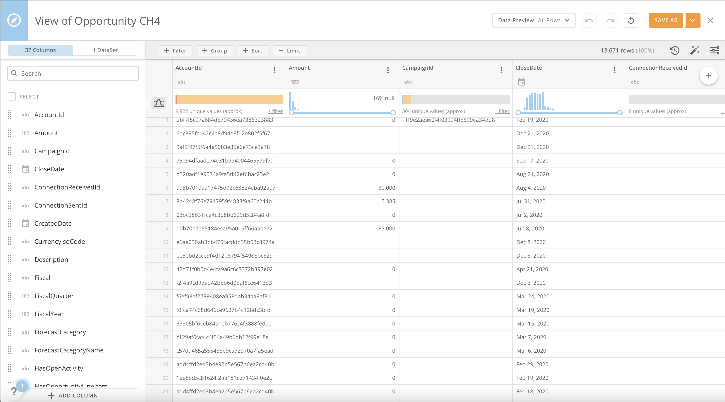
View Name
Preview Rows
Save View
Join Tab
Row Operators
Undo
Redo
Revert
View History
Column Tab
Display Properties
Column Search
Column Options
Column
Selection
Column Handle
Column Data Type
Column Data Profile
AI Suggested Views
Data Profile Toggle
Columns
Add Columns

Slide 2
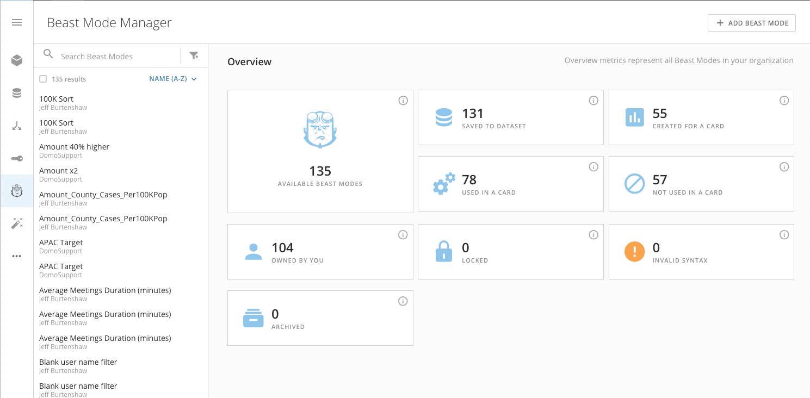
Add Beast Mode
Beast Mode Search
Beast Mode Manager Access
Faceted Search Tiles
Search Results

Slide 3
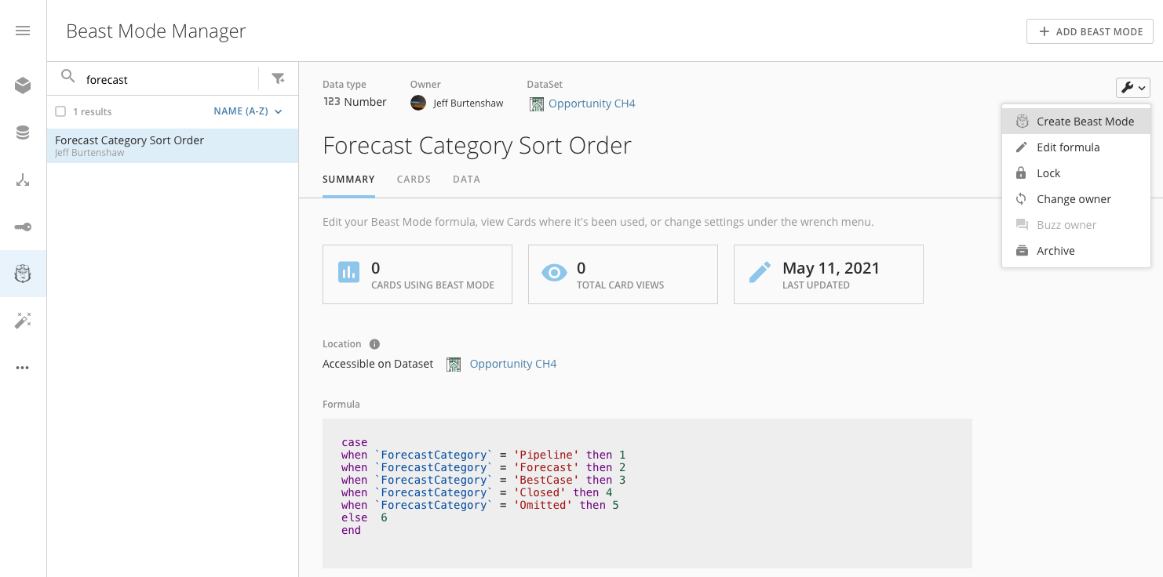
Beast Mode Details
Beast Mode Search
Wrench Menu
Search Results
1
Wrench Menu Options
Beast Mode Manager Access

Slide 4
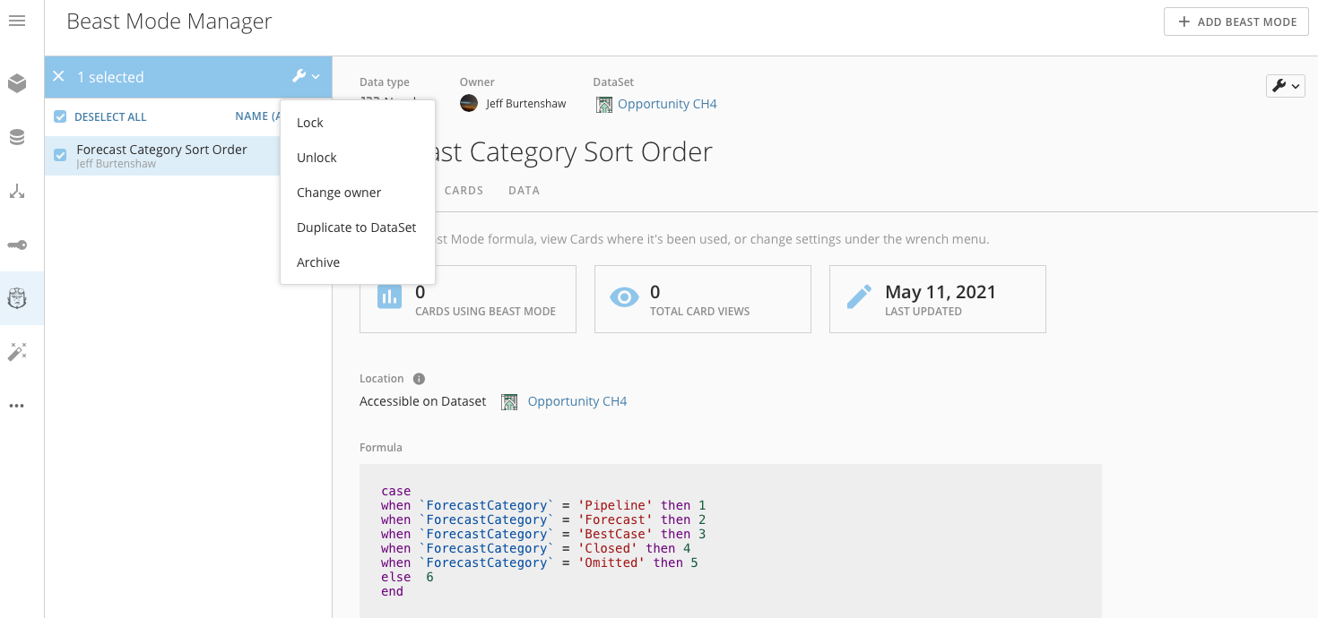
Multi-Select Action Menu
Selection Boxes
Multi-Select Action Menu Options

Slide 5
